Slide 1
Basic Communication manager
Prepared by:Mohab Ahmed

Slide 2
Table of Contents
Project description
Layered Architecture
Modules/Drivers
Project flowchart

Slide 3
Project Description
There are 2 MCUs : MCU_1 and MCU_2
MCU_1 will send [BCM operating] to MCU_2
When MCU_1 finish sending, LED_0 in MCU_1 will be toggled
When MCU_2 finish receiving, LED_1 in MCU_2 will be toggled
MCU_2 will confirm with sending [confirm BCM operating] to MCU_1
When MCU_2 finish sending, LED_0 in MCU_2 will be toggled
When MCU_1 finish receiving, LED_1 in MCU_1 will be toggled

Slide 4
Layered architecture
APP
UTILITEIS
HAL
MCAL

Slide 5
Modules/drivers
APP
Bit_manipulation, registers, standard types
bcm
Dio, timer0

Slide 6
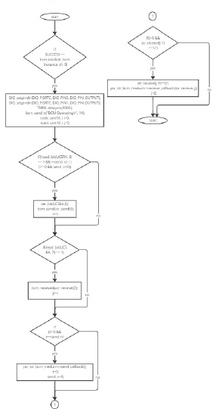
Project flowchart

